Slide 1

Even and Odd Functions
Notes:
The easiest thing to do is to plug in 1 and -1 (or 2 and -2)
if you get the same y, then it’s Even.
If you get the opposite y, then it’s Odd.
If you get different y’s, then it’s Neither.

Slide 2
Algebraically
A function is even if
f(– x) = f(x)
All of the exponents of the variable are even.
A function is odd if
f(– x)= – f(x)
All of the exponents of the variable are odd.
A function is neither if
The exponents are a mixture of odd and even
Notes:
The easiest thing to do is to plug in 1 and -1 (or 2 and -2)
if you get the same y, then it’s Even.
If you get the opposite y, then it’s Odd.
If you get different y’s, then it’s Neither.

Slide 3
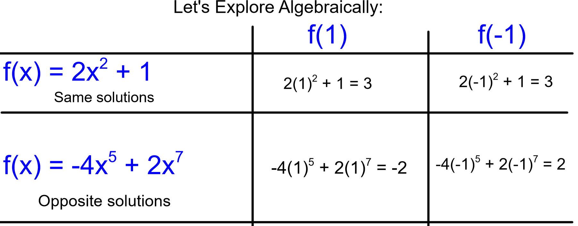

Slide 4
BEWARE OF CONSTANTS
All constants really have a x⁰
Notes:
The easiest thing to do is to plug in 1 and -1 (or 2 and -2)
if you get the same y, then it’s Even.
If you get the opposite y, then it’s Odd.
If you get different y’s, then it’s Neither.

Slide 5
x⁰ is EVEN!!
Notes:
The easiest thing to do is to plug in 1 and -1 (or 2 and -2)
if you get the same y, then it’s Even.
If you get the opposite y, then it’s Odd.
If you get different y’s, then it’s Neither.

Slide 6
Graphically
A function is even if
The graph reflects across the y-axis
(means you can fold it hotdog style and it would match up).
A function is odd if
The graph has 180° rotational symmetry about the ORIGIN
(means you could turn it upside-down & it would still look the same...it must go through the origin).
Notes:
The easiest thing to do is to plug in 1 and -1 (or 2 and -2)
if you get the same y, then it’s Even.
If you get the opposite y, then it’s Odd.
If you get different y’s, then it’s Neither.

Slide 7

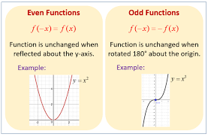

Slide 8
Ex. 1
Even, Odd or Neither?
Algebraically
1
ODD

Slide 9
Even, Odd or Neither?
Ex. 2
Algebraically
x⁰
EVEN

Slide 10
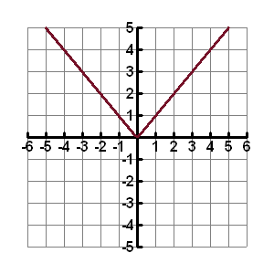
Ex. 3
Even, Odd or Neither?
Graphically
EVEN

Slide 11
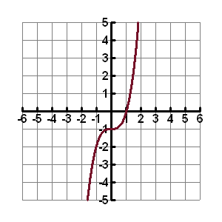
Even, Odd or Neither?
Ex. 4
Graphically
Neither
•

Slide 12
Even, Odd or Neither?
x⁰
¹
EVEN
ODD

Slide 13
Even, Odd or Neither?
x⁰
ODD
ODD
Even

Slide 14
Even, Odd or Neither?
¹
¹ x⁰
neither
ODD
neither

Slide 15
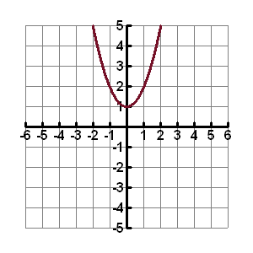
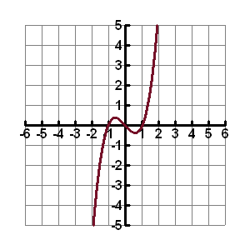
Even, Odd or Neither?
•
EVEN
ODD

Slide 16
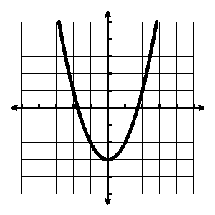
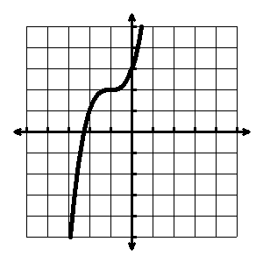
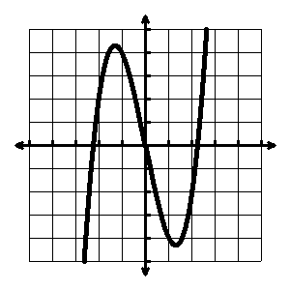
Even, Odd or Neither?
•
•
EVEN
Neither
ODD

Slide 17
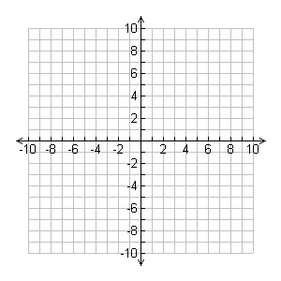
If the dots shown are part of an even function, what points are also on the function?

Slide 18
If the dots shown are part of an odd function, what points are also on the function?

